Slide 1

Technical Operations Analyst United Airlines
Ismail Khan
February 18th, 2021

Slide 2
Problem Statement
Mansourian Insurance is a growing private healthcare insurance provider. The company was founded on the premise that advanced analytics can improve the health insurance industry.
Based on the yearly CDC data, analyze the 2014 published survey results for three States.
Understand the demographics, health, and fitness trends affecting Physical Health for the residents of these States.
Notes:
Mansourian Insurance is a private healthcare insurance provider. The company uses advanced analytics to improve the healthcare industry. We believe that health metrics amongst different demographic groups along with their physical, mental and behavioral attributes can be used to cater better coverage and insurance policies.
Today we are looking at the how demographics, health and fitness trends affect physical health data (measured in the number of days an individual felt sick in the past month) for the State of Connecticut, New Jersey & New York respectively.

Slide 3
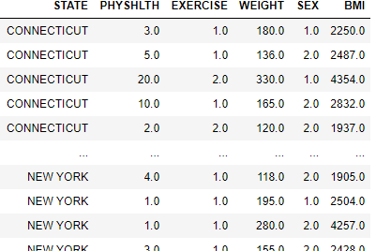
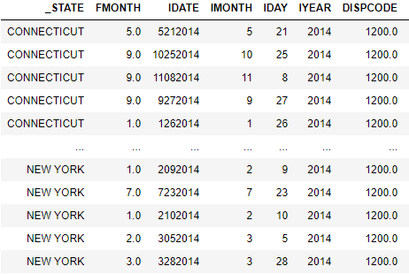
Data Gathering & Cleansing
Notes:
For this analysis, I used the 2014 published CDC data based on the annual surveys performed.
Assumptions: From Physical health, no. of days between 1 - 30 are considered. All other data points are dropped which recorded zero days sick, no response & ‘not sure’. Since we are interested in the number of "bad" days, assumption is made that PHYSHLTH = 88.0 (0 days) is insignificant as zero bad days would skew the mean.
On the right is a screen capture of the raw dataset as it was imported from the given text file.
On the left is screen capture of Physical Health versus some of the independent variables grouped by each State.

Slide 4
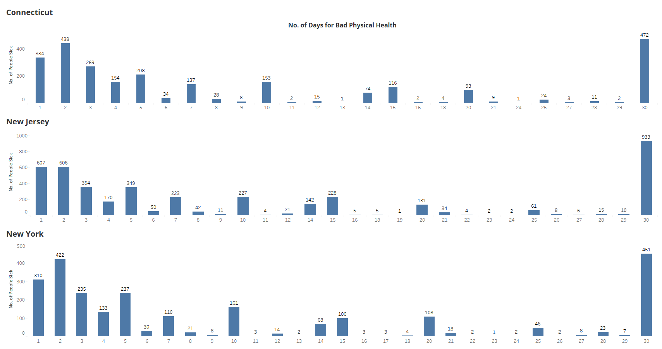
Tri-State Physical Health Histogram
Notes:
Here we investigate what the trend looks like for the residents who felt sick in the last 30 days.
Note that majority of the population felt sick for 10 days or less, which is an average time for how long it takes for someone to get through a common cold.
There were highest number of people sick across all three States who suffered through bad physical health for 30 days.

Slide 5
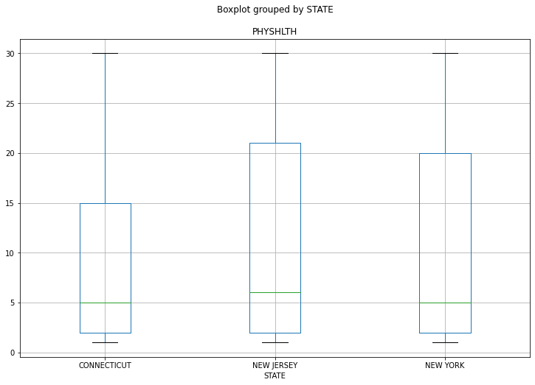
Tri-State Physical Health Boxplot
Notes:
Another comparison of physical health across the three States can be done looking at this boxplot and the Statistics available on the next slide.
Connecticut and New York share the same median of 5.0 days sick, whereas for New Jersey the median was a point higher at 6.0 days.

Slide 6
Tri-State Physical Health Statistics
State | Mean (days) | Median (days) | Standard Deviation (days)
CONNECTICUT | 10.43 | 5.0 | 10.67
NEW JERSEY | 11.73 | 6.0 | 11.23
NEW YORK | 10.93 | 5.0 | 10.80
ANOVA, Statistic | 12.09
ANOVA, P-Value | 5.72 × 10⁻⁶
Notes:
I ran a one-way analysis of variance or the ANOVA , to determine whether there are any statistically significant differences between the means of three or more independent (unrelated) groups, or the three states in this case.
The hypotheses for the test are listed below. A significance level of 0.05 indicates a 5% risk of concluding that a difference exists when there is no actual difference.
The null hypothesis (H0) is that the group means are all equal.
The alternative hypothesis (HA) is that not all group means are equal.
In this case, P-Value = 5.72e-06 which is less than 0.05, therefore these results are statistically significant meaning there are significant differences in sick days across the three states.

Slide 7
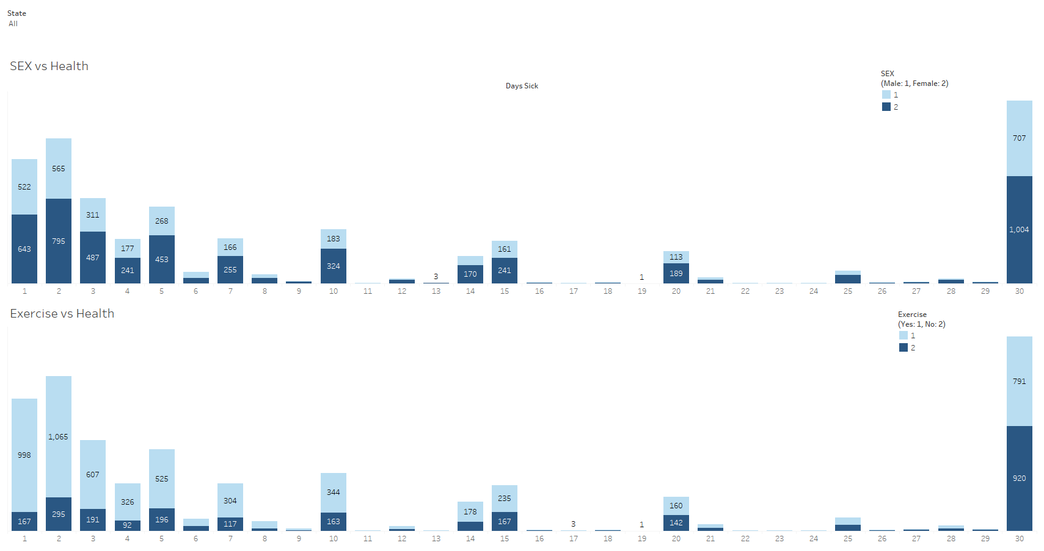
Impact of Exercise & Sex on Physical Health
Notes:
Once we knew that there are inherit differences in the sample dataset, the next step was to measure physical health as a metric across demographic and behavioral trends.
Here is an example of SEX(Male or Female) vs Health & Exercise (Yes, No) vs Health. The idea is to look for any outstanding trends regardless of an individual’s State of residence. In general, there were more women who suffered bad physical health for 30 days than men.
While the number of people who felt sick under 10 days is higher for those who regularly exercised, the number switches when you look at the other extreme of physical health. There are more people who suffered bad physical health for 30 days who did NOT work out than the ones who did.

Slide 8
Correlations Between Dependent Variables & Physical Health
 | PHYSHLTH | EXERCISE | WEIGHT | SEX | BMI
PHYSHLTH | 1 | - 0.285597 | 0.076465 | - 0.012965 | 0.118236
EXERCISE | - 0.285597 | - 1 | - 0.090831 | - 0.05867 | - 0.143793
WEIGHT | 0.076465 | 0.090831 | 1 | - 0.37463 | 0.866612
SEX | 0.012965 | - 0.05867 | - 0.37463 | 1 | - 0.05174
BMI | 0.118236 | 0.143793 | 0.866612 | - 0.05174 | 1
Notes:
EXERCISE & SEX shown above are with the dummy coded variables.
Running correlations amongst these variables, we see weak positive relationships for Weight & BMI, whereas there is a negative relationship for Exercise & Sex.
The relationships between Weight and Physical Health, as well as BMI and Physical Health are also not statistically significant.
There is a moderate and significant correlation between Exercise and Physical Health, which means that individuals who do not exercise regularly also tend to report more sick days.

Slide 9
Multiple Linear Regression Model
Dep. Variable | Model | Method | Prob (F-statistic) | Log-Likelihood
PHYSHLTH | OLS | Least Squares | 5.06 × 10⁻¹⁷⁴ | -32549
R-squared | Adj. R-squared | F-statistic | No. Observations | Df Model
0.09 | 0.089 | 212.3 | 8636 | 4
 | Coefficients | Standard Error | t-value | P > |t|
Y-Intercept | 12.542 | 0.597 | 20.999 | 0.000
EXERCISE | - 6.432 | 0.245 | - 26.21 | 0.000
WEIGHT | - 0.027 | 0.006 | - 4.276 | 0.000
SEX | - 0.847 | 0.308 | - 2.754 | 0.006
BMI | 0.003 | 0.000 | 6.989 | 0.000
Notes:
I ran a multiple regression model to understand the impact of Exercise, Weight, Sex, and BMI (which served as the independent variables) on Physical Health (the dependent variable). For all 4 independent variables, the P-value is less than 0.05 stating that results are statistically significant, meaning that changes in each of the independent variables are related to change in physical health.
In this case, the R-Squared value is much less than 0.50. However, studies that try to explain human behavior generally have R² values less than 50%. Because people are harder to predict than things like physical processes. Therefore, we can still draw important conclusions from the analysis, and we can do so by looking at the statistically significant coefficients of each independent variable.
Regression coefficients represent the mean change in the independent variable for one unit of change in physical health (dependent variable). So, these results suggest for each one unit increase in BMI is associated with a slight increase in physical health, whereas a one unit increase in weight is associated with a slight decrease in physical health. The negative relationship with exercise show that people who did not exercise suffered a decrease in physical health.
Prob(F-statistics) depicts the probability of null hypothesis(all the regression parameters are zero) being true. As per the above results, probability is close to zero. This implies that overall, the regression is meaningful.

Slide 10
Taking it Further
Finding where the significance lies between other variables
Understand how physical health is different amongst other races
Investigate physical health data based on disease trends in the region. Such as how seasonal flu is impacting physical health.
Compare healthcare expenditure per 100k residents versus number of bad physical health days suffered by citizens
Compare health amongst all SES (Socio-Economic Status) levels
Conduct Post-hoc analyses to run comparative studies:
Duncan’s Multiple Range Test (MRT)
Tukey Honest Significance Difference (HSD)
Use the regression model to create supervised machine learning algorithm to predict physical health status based on given features.

Slide 11



